Slide 1
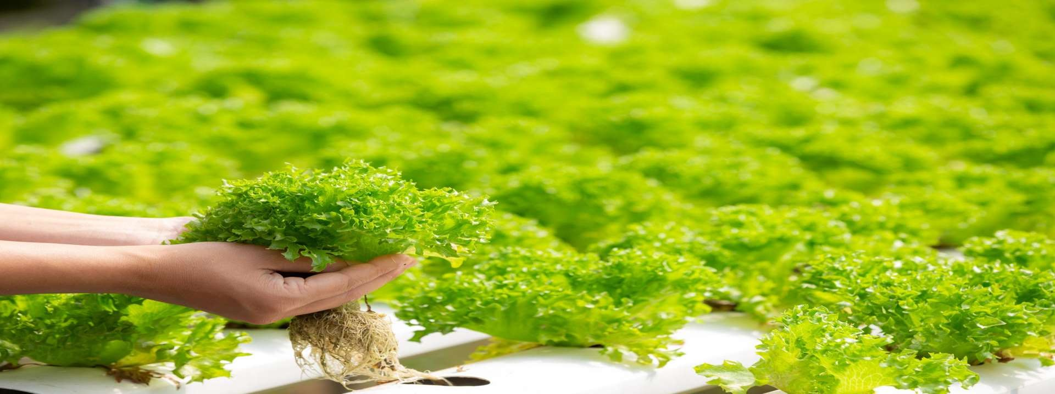


Arduino Microcontroller-Driven Indoor Hydroponic Fodder System
A.K.Ranaweera
ITBNM-2110-0046

Slide 2
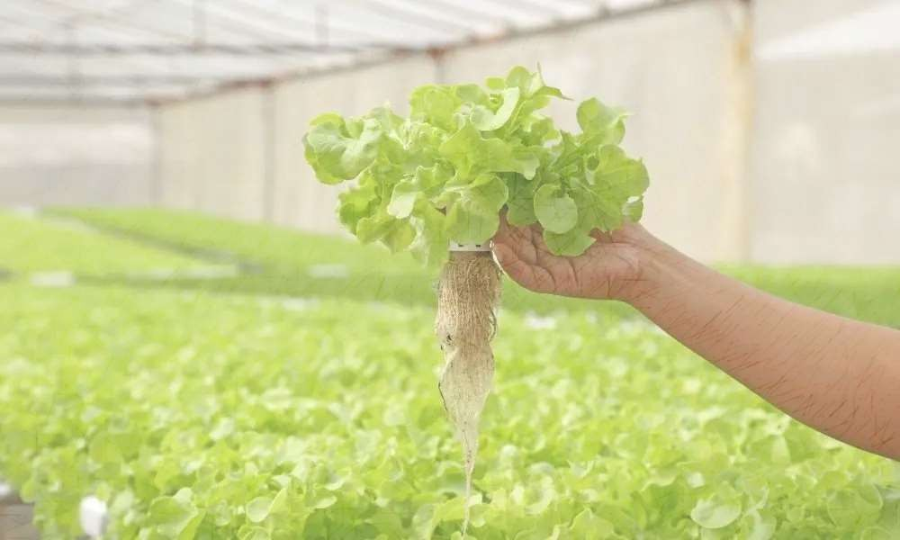
Outline of the Presentation
Introduction
Problem Statement
Motivation and Significance of the Project
Aim and Objectives of the Proposed Project
Major Process
Expected Deliverables
Methodology for the Proposed Project
Hardware and Software Requirements
References

Slide 3
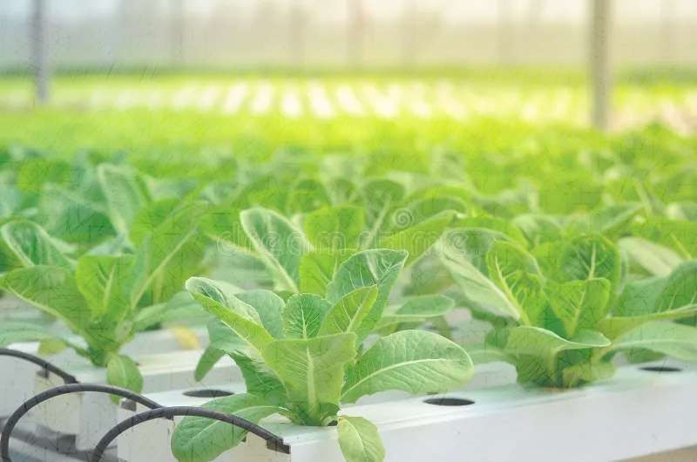

Introduction
Hydroponics is transforming agriculture through indoor growth capabilities . A fully automated mini fodder grow chamber has been developed for rapid indoor fodder production.
The system features a temperature-controlled chamber, grow lights for simulated sunlight, and water/moisture monitoring . An Arduino controller, interfaced with a keypad, collects user inputs on water flow and indoor temperature . Continuous monitoring using water, moisture, and temperature sensors ensures optimal indoor conditions.
A motorized pump, controlled by the Arduino, maintains water levels for ideal moisture conditions . The system automates indoor artificial sunlight cycles as specified by the user . Efficiently managed by the Arduino, the entire operation is repeated regularly without failure . An alarm alerts users if the water tank is depleted, enhancing system reliability . Overall, the system establishes an automatic indoor fodder growth environment using Arduino control.

Slide 4
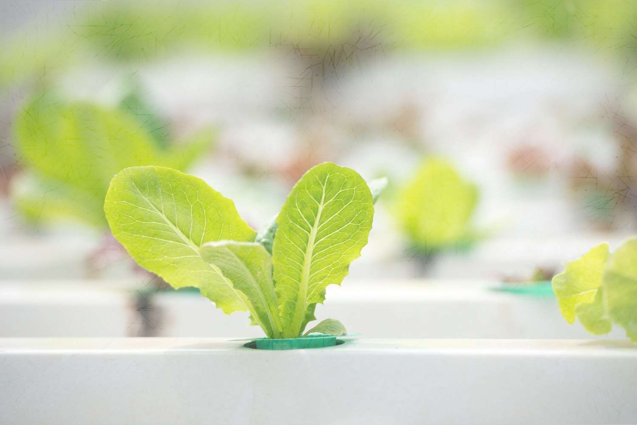


Problem Statement
Traditional agriculture, despite using a small amount of resources, faces limitations in meeting growing food demands due to genetic and chemical constraints . Intensification and expanding land for food production are considered the main options, with 70% of global water usage dedicated to agriculture, driven by unsustainable irrigation practices . Currently, 38% of non-frozen land is used for food production, and projections suggest a need to convert 593 million hectares into agricultural land by 2050 to meet global calorie needs.
This expansion poses a threat to essential ecosystems, particularly rainforests, which house the majority of the world's biodiversity and play a crucial role in carbon balance . Deforestation, driven by industrial agriculture, contributes to anthropogenic carbon emissions and a significant decline in biodiversity, with 52% of vertebrate species richness already destroyed.

Slide 5


Motivation and Significance of the Project
In hydroponic farming, plants are grown in nutrient-rich water solutions rather than soil. Hydroponic farming initiatives are linked to various noteworthy factors and incentives.
Resource Efficiency
Year-round Crop Production
Optimal Nutrient Management
Educational Opportunities
Space Utilization
Faster Growth
Consistency
Community and Economic Development
Innovation and Technology Integration
Food Security
Environmental Sustainability

Slide 6

Aim and Objectives of the Proposed Project
Aim
improvement of hydroponic cultivation using modern technology
Objectives
Sustainable Agriculture: Promote environmentally conscious farming practices that utilize resources efficiently.
Year-round Crop Production: Ensure consistent, uninterrupted crop output unaffected by seasonal
variations.
Water Conservation: Optimize water usage through reduced waste and improved irrigation techniques.
Maximize Space Utilization: Utilize vertical farming and small hydroponic systems to efficiently use available land or space.

Slide 7
Enhance Crop Quality: Cultivate advanced crops with improved flavor, nutritional content, and aesthetic
appeal.
Increase Crop Yield: Surpass conventional soil-based farming in terms of yields per unit area.
Illness and Vermin Control: Mitigate the risk of soil-borne illnesses and pests through regulated growing
environments.
Localized Food Production: Foster local food security by growing fresh produce within the community.
Educational Outreach: Provide educational programs to the public and schools, promoting awareness of
modern farming methods and sustainability.
Job Creation: Establish and maintain hydroponic farming systems to create employment opportunities in the community.
Food Innovation: Encourage experimentation with a variety of crops, especially those less common in
traditional agriculture, to promote food innovation.
Adaptability to Varied Environments: Develop flexible hydroponic systems capable of adapting to diverse environmental and geographic conditions.

Slide 8
Major Process
An auto indoor hydroponic fodder grow chamber is designed to facilitate the automated and controlled cultivation of nutrient-rich fodder for livestock.
Germination Containers: Evenly distribute seeds in specialized trays or containers with built-in mechanisms for maintaining optimal humidity and temperature levels.
Automated Watering System: Employ an automated watering system to ensure consistent and sufficient
moisture for germinating plants.
Nutrient Delivery: Supply essential nutrients through hydroponic fertilizer solutions, delivered to growing roots via regulated mechanisms or pumping systems.
Temperature and Humidity Control: Continuously monitor and control the environment within the grow chamber for both temperature and humidity, crucial for promoting healthy and rapid plant growth.
Lighting System: Utilize artificial lighting systems, such as LEDs, to provide steady and regulated light cycles, mimicking the effects of natural sunlight for efficient photosynthesis.

Slide 9
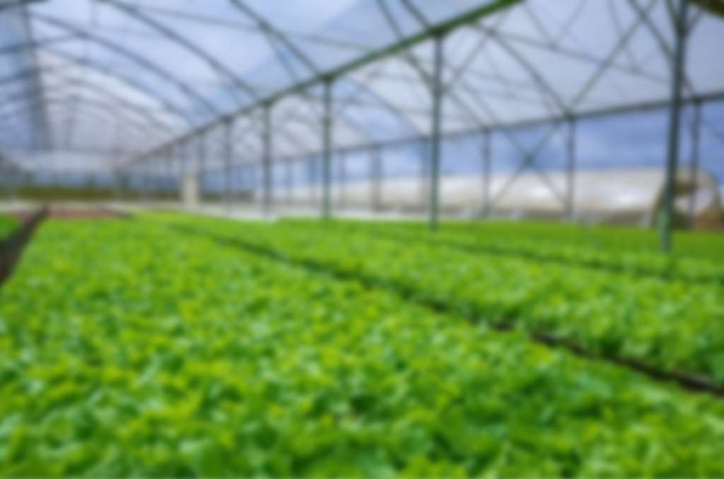


Expected Deliverables
Design Diagrams
Block diagrams
Test Cases and Test Results
Source Codes
User manual
Mobile app

Slide 10

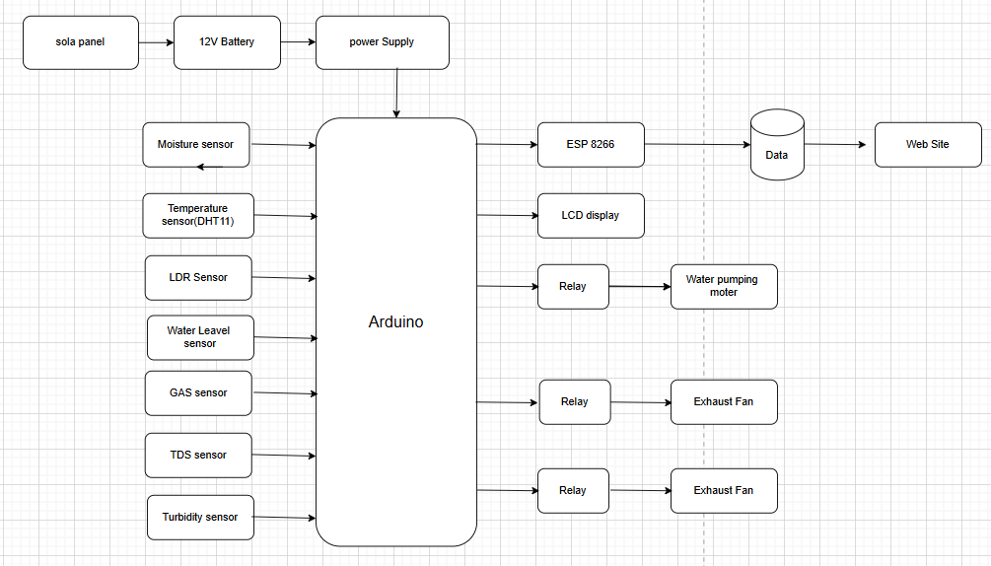
System Overview
Block Diagram

Slide 11
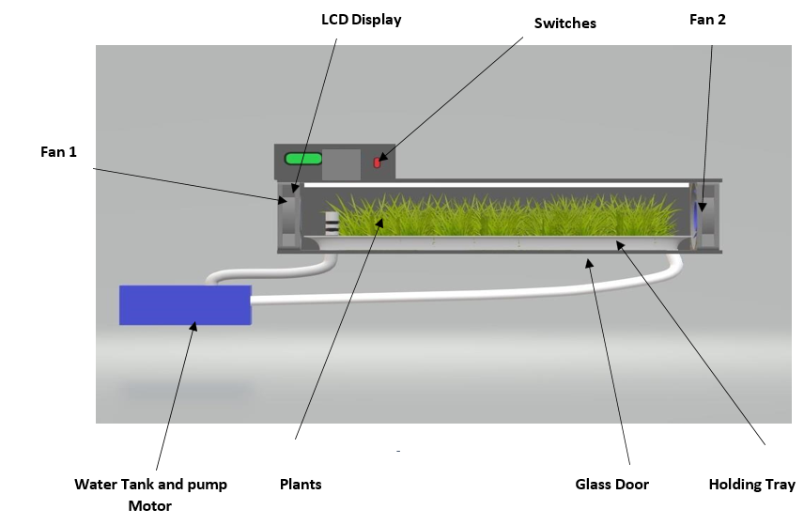
Design Diagram

Slide 12

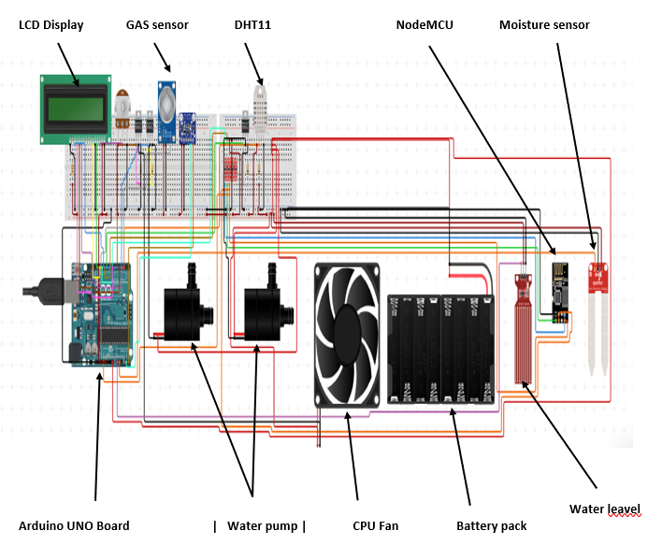
Circuit Diagrams

Slide 13

Hardware and Software Requirements
Hardware Requirement
Arduino
Water Sensor
TDS Sensor
Turbidity Sensor
Moisture Sensor
Temperature Sensor
Artificial Solar Light(LDR Sensor)
Pump Motor
LCD Display
LED’s
Switches
Water Tank
Pipes and Tubes
Resistors
Capacitors
Diodes
Transistors
Outer Frame
Mounts and Fittings
Supporting Frame
Screws & Joints
GAS sensor
Sola panel

Slide 14
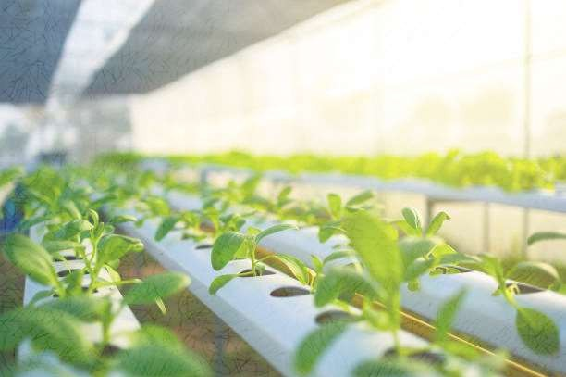
Software Requirement
Operating System: Any Android/ios Phone
Development Environment:Visual Studio Code
Languages: React Native (JSX)
Minimum 4GB RAM

Slide 15

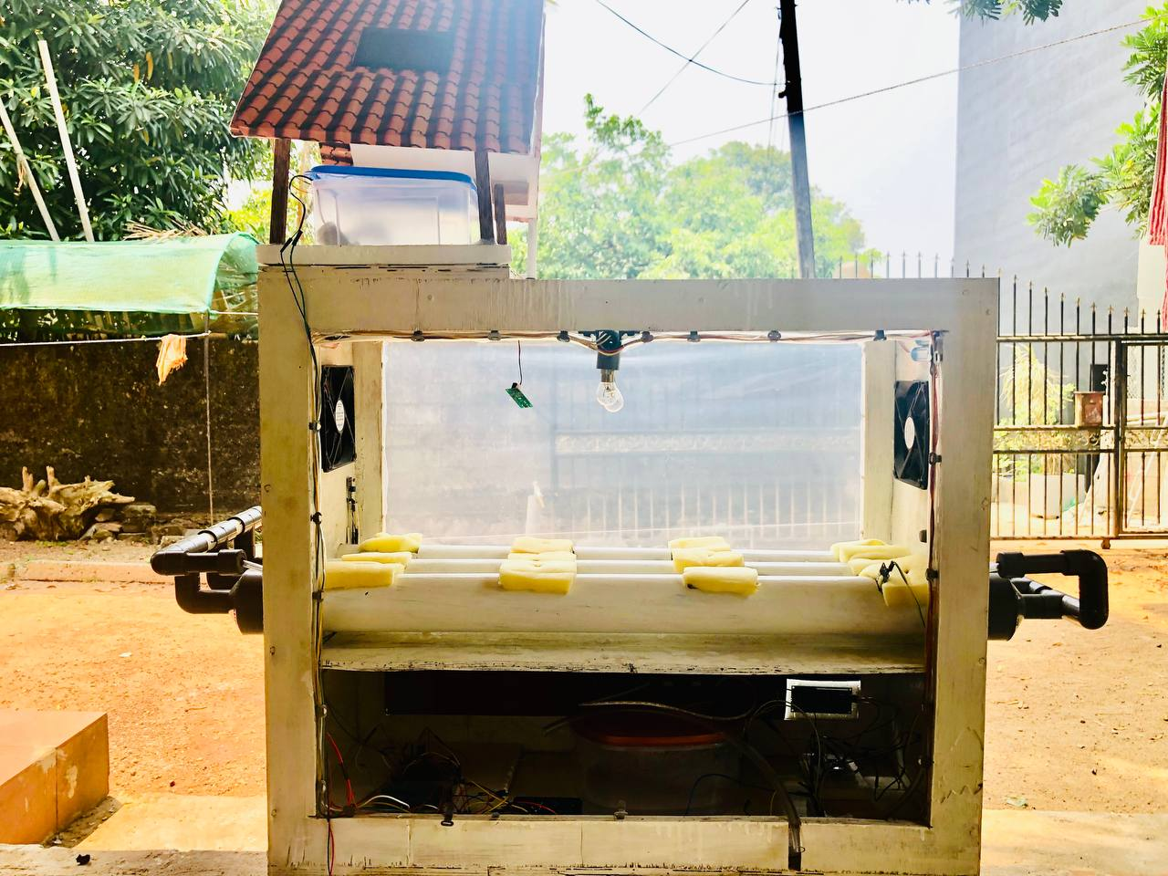
Ongoing Project

Slide 16
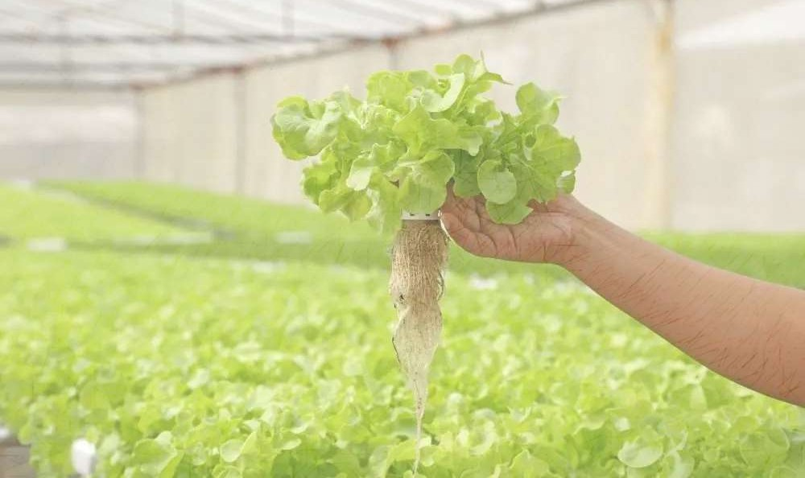

References
M. U. C. J. E. Chowdhury, "Evaluation of hydroponic systems for organic lettuce production in controlled environment," 06 08 2024. [Online]. Available: https://www.frontiersin.org/journals/plant- science/articles/10.3389/fpls.2024.1401089/full
S. S. Turakne, 11 03 2021. [Online]. Available: https://ijsrset.com/IJSRSET2183177.
https://journal.hmjournals.com/index.php/IJAAp International Journal of Agriculture and Animal
Production
https://doi.org/10.32628/IJSRSET83177 International Journal of Scientific Research in Science
https://doi.org/10.4038/kjms.v6i1.108 KDU Journal of Multidisciplinary Studies
www.mdpi.com/journal/sensors vertical hydroponics; indoor farming; automated system
https://doi.org/10.1186/s40538-024-00641-6 Lim et al. Chem. Biol. Technol. Agric.

Slide 17
